Slide 1
Applied Micro Methods
Difference-in-Difference

Slide 2
Overview: 3 Methods Used by Reduced-Form Applied Micro Researchers
Regression Discontinuity Design
Instrumental Variables
Difference-in-Difference
Today: Difference-in-Difference
Motivation: To estimate unbiased causal treatment effects under identifying assumptions believed and shown to be reasonable
Notes:
It’s harder to submit a difference-in-difference paper because the bar is higher. Consequently, try to use the first two methods first before applying difference-in-difference.

Slide 3
Example: What is the impact of (liquor) price advertising on prices?
One approach: cross-sectional
Suppose in 1995, advertising was allowed in Boston, but not in Rhode Island
Log of Liquor Real Price Index
Year Boston Rhode Island
1995 3.9 4.1
Cross-Sectional Estimate: -0.2;
Possible Causal interpretation: Price advertising causes prices to be 20 percent lower than they would otherwise be

Slide 4
Year Boston Rhode Island
1995 3.9 4.1
Identifying Assumption of Cross-Sectional Approach
There are no systematic differences between the treatment and control groups that would have caused the outcome levels to be different in the absence of treatment
Or, once allowing for controls in a regression:
There are no systematic differences between the treatment and control groups that would have caused the outcome levels to be different in the absence of treatment, at least once we control for observed differences
What could cause problems here?
-If Boston consumers are price-sensitive and therefore have lower MWP, and force their politicians to allow price advertising, then estimate will be biased downward, overstating how much price advertising actually reduces prices (C causes A&B)
-If politicians are pressured to allow advertising when prices are high (B causes A), then the estimate will be biased upward, understating how much price advertising actually reduces prices
s

Slide 5
If you HAD to use cross-sectional variation, what could you do to strengthen the argument?
i) Make a strong institutional/theoretical argument as to why the variation is as-good-as-random
ii) Show that treatment and control groups look similar on other exogenous characteristics (labor costs, land costs, wholesale liquor costs, family income, etc.)
iii) Show that estimates do not change when you include meaningful controls
Intuition behind both tests: In many contexts you can argue that if treatment is uncorrelated with observables, it is probably also uncorrelated with unobservables
iv) (Falsification exercise) Show that there is no difference in price when the law on price advertising was the same
v) (Falsification exercise) Use the same estimating framework to show that there is no effect of liquor advertising on the prices of other goods (e.g., tobacco) where there was no variation in the treatment
Advice: Never rely on cross-sectional variation unless you have excellent institutional, theoretical, and empirical reasons as to why that variation is exogenous

Slide 6
Suppose in 1995, advertising was allowed in Boston, but not in Rhode Island, but it became allowed in 2000
Log of Liquor Real Price Index
Year Rhode Island Advertising allowed?
1995 4.1 No
2005 4.1 Yes
Time Series Estimate: 0
Causal Interpretation: Allowing price advertising has no effect on liquor prices
Identifying Assumption: In the absence of treatment, the outcome would have remained at the same level as it was during pre-treatment
Problems?
-Perhaps retail costs or demand went up over time, implying that we understate the effect advertising has on reducing prices
-Any other time-varying factor that affects equilibrium prices that is not due to the change in advertising law would bias your estimate

Slide 7
Advice: If you must identify off of time-series variation, you need LARGE and ABRUPT changes in treatment, and you want outcomes that will be affected quickly by the treatment
Example: Dobkin & Nicosia (2009)
Question: The effect of supply shocks (a.k.a. the “War on Drugs”) on Methamphetamine Price & Quality
Supply shock: In May of 1995, the DEA shut down two suppliers who provided 50 percent of the precursors of meth
Note: this was a LARGE, ABRUPT shock
Also note: one would expect price and quality to adjust quickly to such a shock, if the shock caused such effects

Slide 8
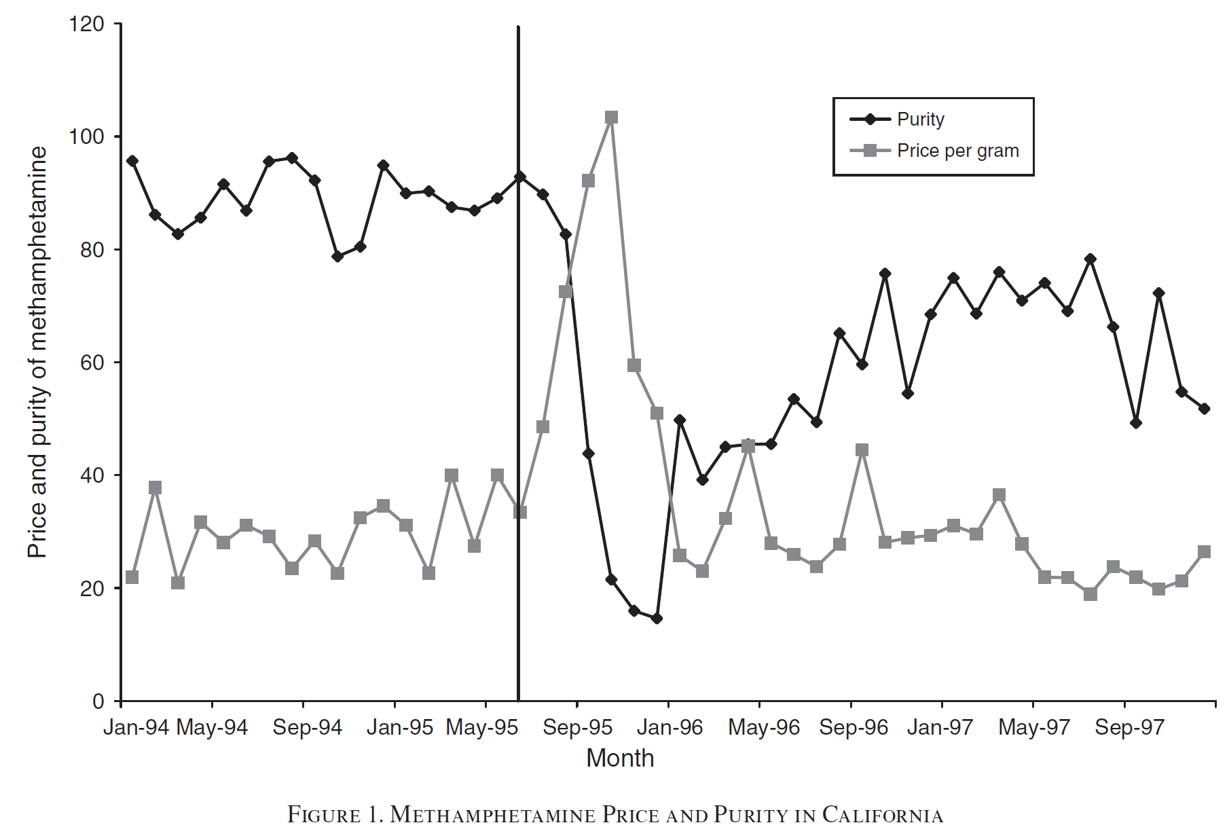

Slide 9
A solution to these very strict identifying assumptions? Difference-in-Difference
Suppose in 1995, advertising was allowed in Boston, but not in Rhode Island. Rhode Island allowed advertising in 2000.
Log of Liquor Real Price Index
Year Boston (control) Rhode Island (treatment)
1995 3.9 4.1
2005 4.15 4.1
Difference: 0.25 0
Difference-in-Differences -0.25
Literal Interpretation: Prices in Rhode Island fell 25 percent relative to prices in Boston, from 1995 to 2005
Causal Interpretation: Allowing price advertising caused a 25 percent reduction in liquor prices

Slide 10
Identifying Assumption of Difference-in-Difference: Absent the treatment, the change in the outcome for the treatment and control groups would been the same over time
Alternatively: Absent the treatment, the difference between the treatment and control groups would have remained the same in the post-period as in the pre-period
What if we control for time-varying exogenous factors directly?
Add on the condition “once we control for time-varying observable factors”
Note: Ideally we don’t want to have to control for time-varying factors
If time-varying factors diverge systematically for the treatment versus the control group and thus affecting our treatment effect estimates, how sure can we be that including unobserved time-varying factors wouldn’t also affect our estimates?
s

Slide 11
The difference-in-difference estimator
Outcome_{it} = b₀ + b₁post_{t} + b₂treat_{i} + b₃(post*treat)_{it} + e_{it}
Difference-in-Difference Estimator: b₃
In other words, if the data look like this:
Log of Liquor Real Price Index
Year Boston (control) Rhode Island (treatment)
1995 3.9 4.1
2005 4.15 4.1
=> b3 = -0.25
s

Slide 12
How is it that b₃ captures the difference-in-difference estimator?
Outcome_{it} = b₀ + b₁post_{t} + b₂treat_{i} + b₃(post*treat)_{it} + e_{it}
Predicted Log Price Indexes (i.e., averages!)
Year Boston (control) Rhode Island (treatment)
1995 b0 b0+b2
2005 b0+b1 b0+ b1+b2+b3
Difference b1 b1+b3
Difference-in-Difference b3
Notes:
The point of the “post” dummy is to take out the time effect.

Slide 13
Difference-in-Difference Analysis: Implementation
Panel Data, and Differing Times of Treatment
Outcome_{it} = b₀ + b₁YearFE_{t} + b₂StateFE_{i} + b₃(post*treat)_{it} + e_{it}
s
Notes:
Comparing the differences between the two groups in the pre-period with the differences between the two groups in the post-period.
Note that b2 is the coefficient associated with the fixed effect for observation i.

Slide 14
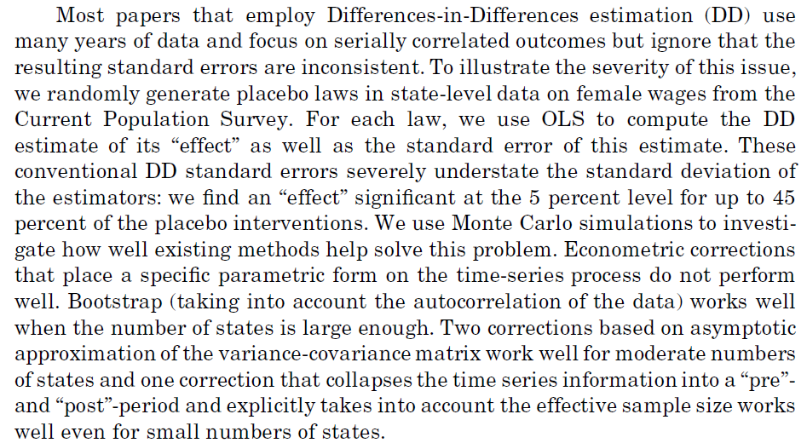
Standard Errors (IMPORTANT!)
From Bertrand, Duflo, and Mullainathan (2004)
Notes:
To obtain proper standard errors, apply Bootstrap methods or cluster the standard errors at the level of treatment. Note that clustering is the standard approach, always cluster standard errors by group, and try to have at least 40 cluster groups. If you only have a finite set of clusters, or if there is another problem with clustering, then you may need to employ Bootstrap techniques.

Slide 15
2. Standard Errors (IMPORTANT!)
Practical Takeaway - When doing a DD approach using panel data either
i) Cluster standard errors by group (e.g., by state, NOT state-by-year cell)
[this is the most common solution implemented]
ii) If number of clusters is relatively small, aggregate data into pre- and post-treatment or bootstrap

Slide 16
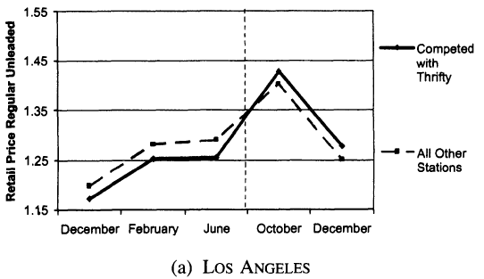
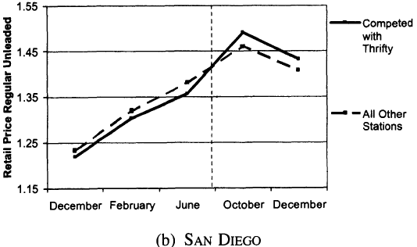
Tests of Identification
i) (Show Me the Data!)
Graph the outcomes for treatment and control groups before and after treatment; do they appear to be following the same trajectory pre-treatment?
(from Hastings, 2004)
s

Slide 17
Tests of Identification
ii) Show how time-varying controls (that are exogenous to the treatment) vary before versus after treatment
Intuition: If exogenous controls diverge significantly after treatment, it makes one worry that the control group was not really a good counterfactual for the treatment group
Note: we’re especially worried about diverging changes, not different levels
s

Slide 18
Tests of Identification
iii) Examine whether difference-in-difference estimator changes when you include time-varying controls that are exogenous to the treatment
Similar intuition: If including exogenous time-varying controls causes the estimate to (say) decrease, we worry that treatment and control groups would have diverged anyway
Put differently: If including observables changes the estimate, how can we be sure that including unobservables wouldn’t further change the estimate?
That intuition formalized: Altonji, Elder, and Taber (2005)
Summary: Can calculate estimate of how bad selection on unobservables has to be relative to observables in order to fully explain the result
Can also estimate selection bias, assuming selection on unobservables is similar to selection on observables
s

Slide 19
Tests of Identification
iv) Estimate leading dummy indicators as placebo tests
Test: Do the treatment and control group diverge pre-treatment?
More formally:
Outcome_{it} = b₀ + b₁YearFE_{t} + b₂StateFE_{i} + b₃(post*treat)_{it}
+ b₄ (year_prior_to_treatment*treat)_{it} + e_{it}
Where b₄ is your estimate of interest (hopefully b₄ = 0!!!). We don’t want to see any divergence in the year before treatment.
Or: Drop all post-treatment data, and assume treatment had occurred one year earlier, two years earlier, etc., and use the same difference-in-difference research design
s

Slide 20
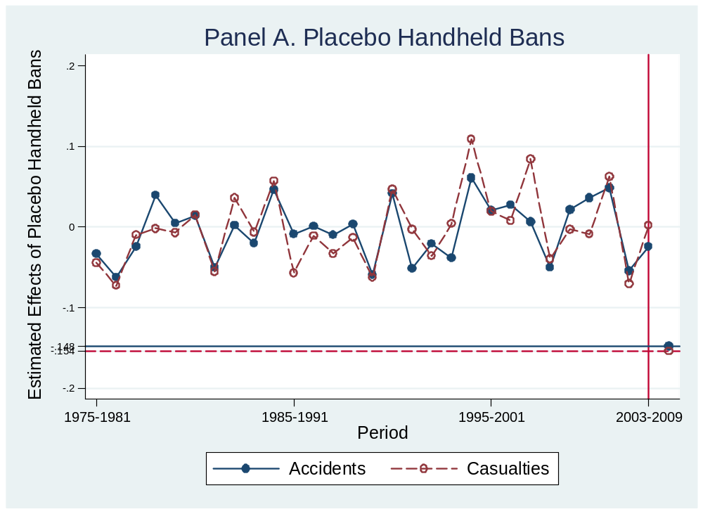
Tests of Identification
An amped-up version of this test:
Note: mean placebo estimate are -0.005 and -0.003 for accidents and casualties, respectively
The actual treatment estimates were -0.15 and -0.15, respectively
Takeaway: There is no historical evidence that treatment states tend to generally diverge from control states

Slide 21
Tests of Identification
v) Falsification Tests: Use the same research design to show that treatment does not affect outcomes it should not affect
Example: The effect of maternity/paternity leave legislation on wages
Who do you expect the law to affect? Relatively young women (say, 20 – 35)
One falsification test: Older women (say, age 35 – 50)
LHS variable is wages for older women rather than younger women
Another falsification test: Younger men (say age 20 – 35)
Intuition: Even though most laws technically apply to men as well, practically relatively few men use the benefits
If you found effects on men or older women, it implies that the treatment and control states were on differing underlying trends
Note: Be careful; sometimes treatments can have legitimate spillover effects on other groups
s

Slide 22
Tests of Identification
vi) Triple-Difference
Example: You worry that the earnings of young women in states that choose to adopt mandatory maternity leave laws are trending differently from those of young women in other states
Potential Solution: Add older women as the third difference:
-Treated state versus control state
-After versus before adoption of the law
-Young women versus old women
Now: In order for there to be a problem, you have to believe that the change in older women’s earnings is not a good counterfactual for the change in young women’s earnings in treatment states had there been no treatment.
s

Slide 23
Tests of Identification
vi) Triple-Difference
Implementation:
Data: Earnings for females aged 20 to 50 over time
Treat = 1 if law is in effect (assume all adopt law at same time)
Young = 1 if 20 <age<35; 0 otherwise
Outcome_{it} = b₀ + b₁post_{t} + b₂treat_{i} + b₃young_{it}
+ b₄ (post*treat)_{it} + b₅(post*young)_{it} + b₆ (treat*young)_{it}
+ b₇(post*treat*young)_{it} + e_{it}
DDD estimator is b₇
Notes:
Three Differences: state versus state; before versus after treatment; younger women versus older women

Slide 24
Tests of Identification
vii) Show the effects are larger for subgroups whom you would expect to be more affected, ex ante

Slide 25
Tests of Identification
viii) Include state-specific linear time trends
Intuition: Ask whether deviations from trend in the post period relative to the pre-period are different for the treatment group than the control group
Example:
State Year MI_trend TX_trend
MI 2000 1 0
MI 2001 2 0
MI 2002 3 0
MI 2003 4 0
MI 2004 5 0
MI 2005 6 0
TX 2000 0 1
TX 2001 0 2
TX 2002 0 3
TX 2003 0 4
TX 2004 0 5
TX 2005 0 6
Notes:
Warning: If you have dynamic treatment effects and you include trends, then you can attenuate your estimates.

Slide 26
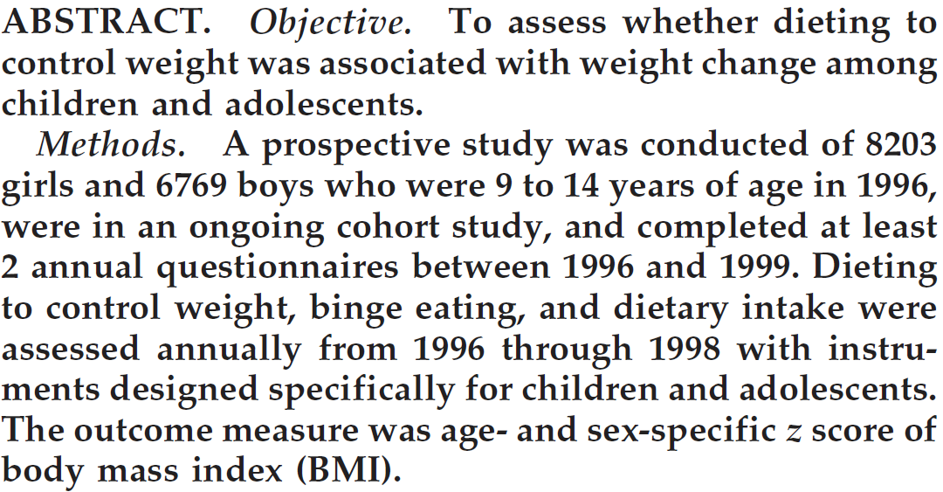
Warning: Think really hard about whether you believe the underlying identification assumption
Example from “Relation Between Dieting and Weight Change Among Preadolescents and Adolescents” published in Pediatrics in October of 2003

Slide 27
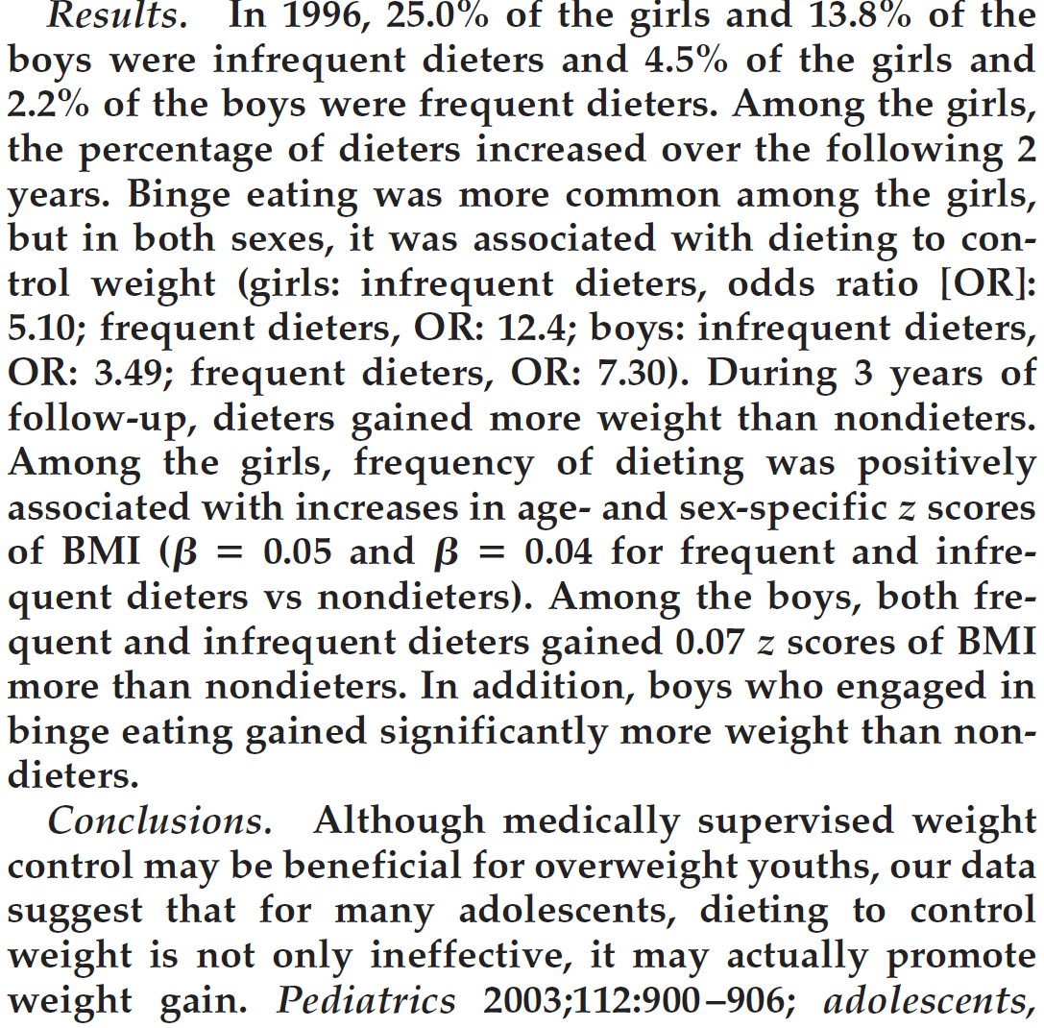

Slide 28
Empirical finding: Weight gain is correlated with dieting and binge-eating
Interpretations:
Dieting causes weight gain, likely through binge eating (authors’ interpretation: A causes B)
Binge-eating causes kids to both a) gain weight, and b) attempt to diet
(C causes A&B)
Kids predisposed to gain weight both choose to diet, and also binge-eat
(which could be a result of the dieting, or could be a result of being
predisposed to weight gain) (B causes A)
Note #1: Difference-in-Difference here doesn’t get you around EITHER of the other two potential interpretations of the correlation!
Note #2: Saying that overweight kids diet is NOT a potential interpretation of the finding; the story has to be that kids predisposed to gain weight choose to diet, which isn’t as likely, but still quite plausible

Slide 29
Other Issues
What if you only have one treatment group, like a state?
How do you get “good” estimates, and how do you do inference?
One possibility: Synthetic Control Approach
See Abadie, Diamond, and Hainmueller (2010) in JASA
Intuition: Construct a “synthetic control”, or a weighted average of other states. Endogenously select the weights so that the synthetic control matches up well with the treatment state in the pre-treatment period
Notes:
Synthetic Control is a way of coming up with an estimate when you only have one treatment state.

Slide 30
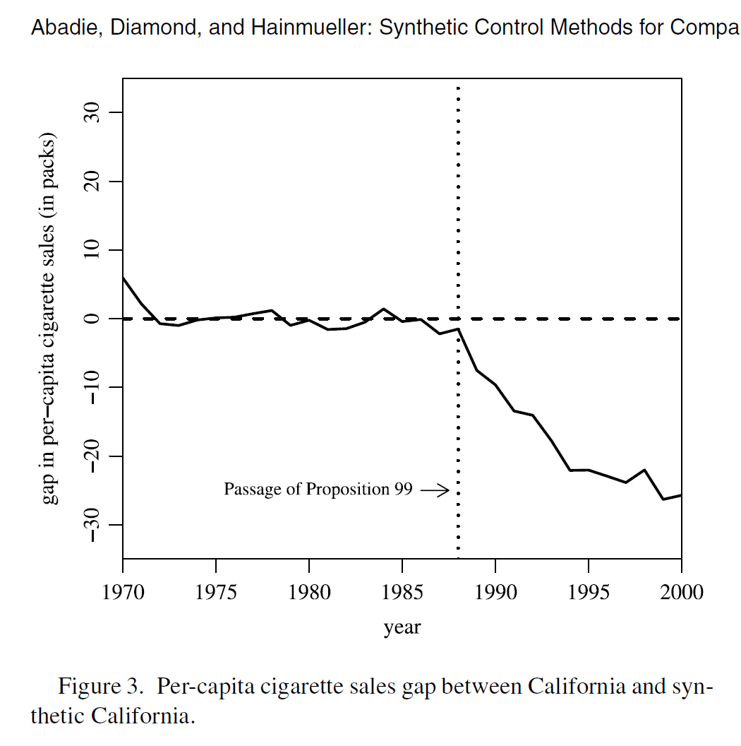

Slide 31
How do you do inference in this approach?
Intuition:
1) Measure how much treatment differs from synthetic control in the post period, relative to the pre period
2) Ask how large that ratio is relative to ratio of other control states compared to the synthetic control
Example: if the ratio for the treatment state is the largest compared to 49 other states, then the one-sided p-value is less than 1/49, or 2%

Slide 32
Other Issues
What if you only have one treatment that appears to affect everyone?
Examples:
-Mandatory Paternity/Maternity Laws
-Federal Reserve changes interest rates
One option: Time-series estimate, if have fine data, and if treatment is large and abrupt, and if you expect the outcome to be affected immediately
For everyone else: Need to find one group that ex ante should be affected more than the other; you can compare groups in which one group was more affected by treatment than another
Example: Young women versus older women, or young women versus young men, etc.

Slide 33
Other Issues
Log versus levels:
Consider the following homicide rates (in levels) per 100,000 population:
Treat Control
Pre 2 20
Post 4 30
Difference 2 10
Difference-in-Differences: -8
Causal Interpretation: Treatment caused a (level) reduction in homicide rates of 8 homicides per 100,000 population
Identifying Assumption: In the absence of treatment, the treatment states would have had an additional 10 homicides per 100,000 population (i.e., from 2 to 12)

Slide 34
Continued…
Now, the same data, except in logs:
Note: Using the log of the rate is almost identical to using log of homicides, and controlling for log of population on the RHS
Treat Control
Pre 0.69 3.00
Post 1.39 3.40
Difference: 0.7 0.40
Difference-in-Differences: 0.30
Causal Interpretation: Treatment caused a 30 percent increase in homicide rates
Identifying Assumption: In the absence of treatment, the treatment states would have had a 40% increase in the homicide rate (or, equivalently, a 40% increase in the number of homicides conditional on population)
Note: Conclusions are very different in this case, using levels we estimate a reduction in homicide rates, and in logs we estimate an increase.

Slide 35
Continued…
The critical issue in deciding between log and levels specification in difference-in-differences: Do you believe that the “time effects” will have the same absolute effect on the homicide rate, or the same relative effect on the homicide rate?
My view: In general, log specifications seem more reasonable to me
Treat Control
Pre 2 20
Post 2 10
Difference-in-Differences: 10
Causal interpretation: Treatment caused the homicide rate to increase by 10 homicides per 100,000 people.
Identifying Assumption: In the absence of treatment, the homicide rate in the treatment state would have fallen from 2 homicides per 100,000 population to -8 homicides per 100,000 population
THIS CANNOT BE TRUE!
An alternative to log or level specification: Use a count model like Negative Binomial

